Slide 1

Tag Engine for LabVIEW
A SCADA-like tag variable engine for LabVIEW
Ryan Porter, P.Eng.
porter@canterautomation.com
porter on lavag.org

Slide 2
Overview
What is it?
Why it could be useful?
How to use it (example)?

Slide 3


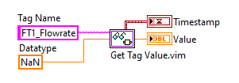
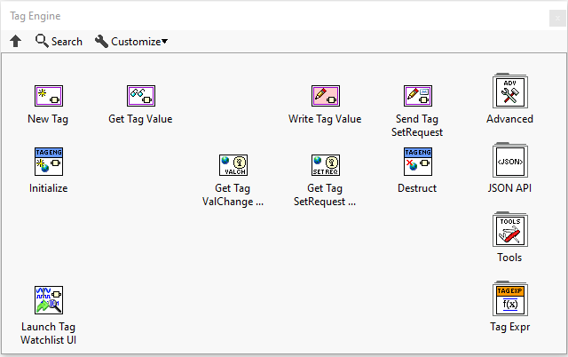
What is the Tag Engine?
A toolkit that simplifies data exchange between code modules by providing global access to named variables (tags).
Open source, BSD 2-Clause license.
Github: github.com/rfporter/tag-engine
VIPM: vipm.io/package/tag_engine
Similar to:
NI Current Value Table Toolkit
GPower VI Register Toolkit

Slide 4


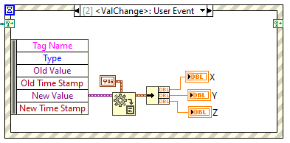
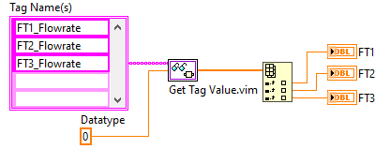
What’s New?
Tag values stored as variant. All LabVIEW data types are supported.
Malleable VIs are used to provide a convenient interface for reading and writing tags.
Tags can trigger a Value Changed user event on write
Timestamp of last value change is stored alongside the tag data

Slide 5

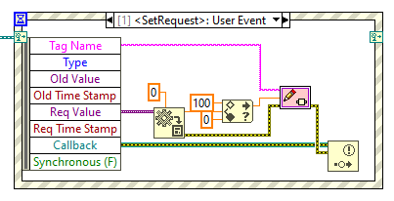
What’s New?
Can send a request to change the value of a tag (using a Set Request user event) rather than writing to the tag’s value directly.

Slide 6
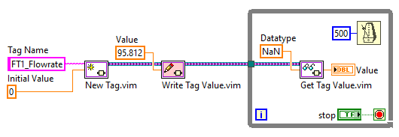
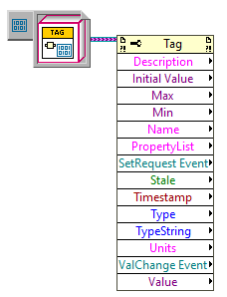
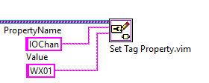
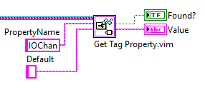
What’s New?
Tags are stored in Data Value References. The API can use either tag's name or the tag's data value reference wire.
Can store tag properties alongside the tag data. Standard properties are description, units, max value, min value.

Slide 7
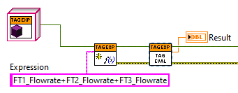
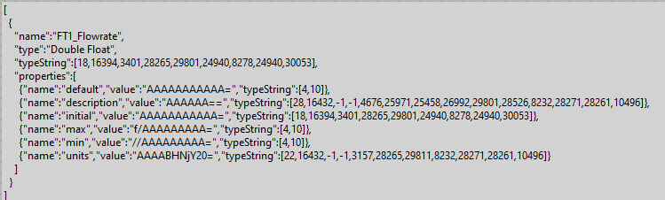
What’s New
Tag names can be used in math expressions directly, using the provided Tag Expr library (extension of muParser for LabVIEW).
Tag configuration can be stored in JSON format.

Slide 8
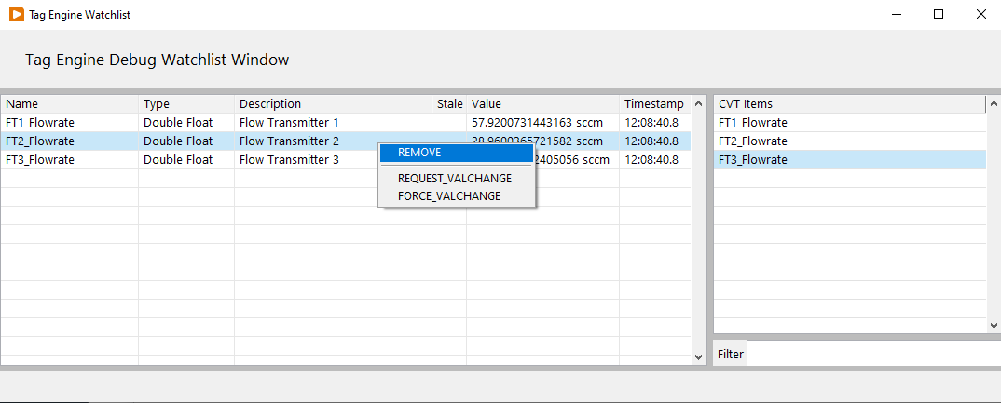
What’s New
Tag Watchlist Window

Slide 9

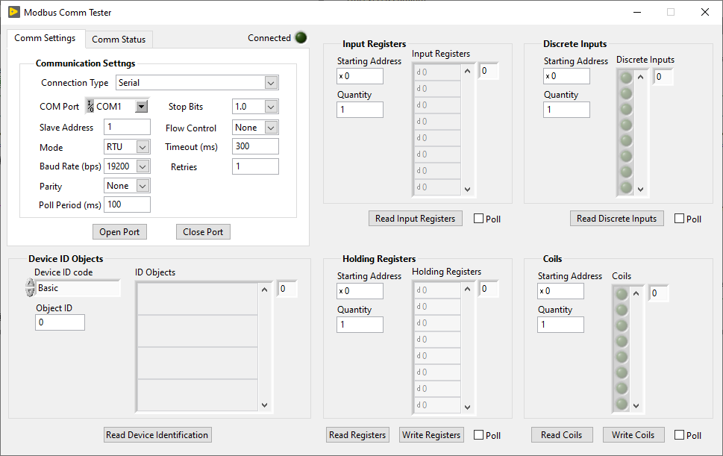
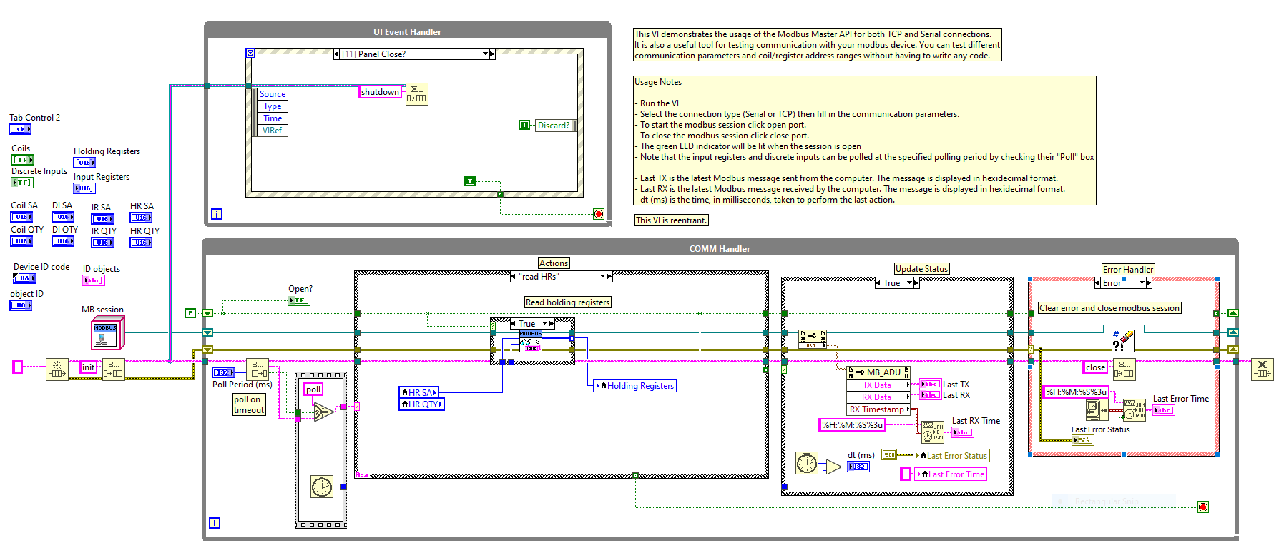
Why is this Useful?

Slide 10
Small App: What’s Wrong?
Device communication is tightly coupled to the UI. Data is passed using controls and indicators.
Making a change to the UI can break or modify the behavior of the device communication loop.
Diagram quickly becomes a mess when more communication or logging loops are added.
Diagram quickly becomes a mess when more complex UI logic is added.
The code is not modular. You can’t easily move the device communication loop into a subVI.
Not good for Version Control.

Slide 11
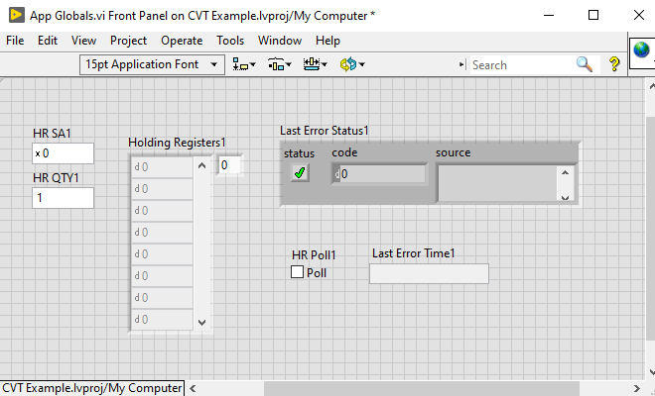
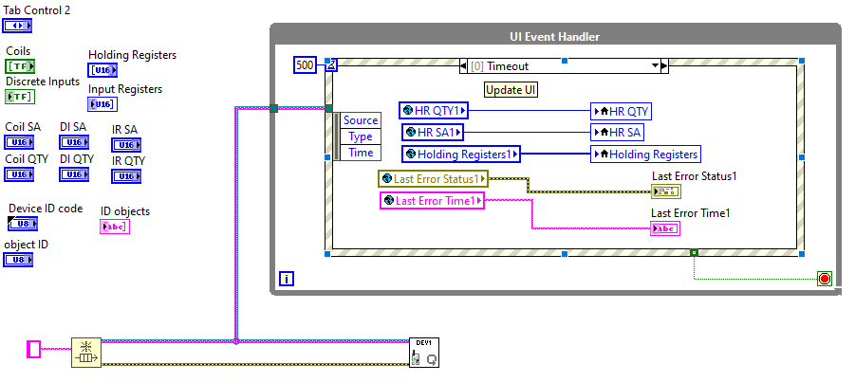
Simple Solution

Slide 12
What’s wrong with Global Variables?
Race Conditions (usually)
Low modularity (usually)
Low reusability (usually)
Lossy communication

Slide 13







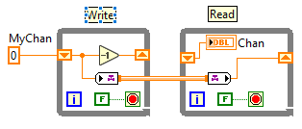
Other Solutions…
Queues
Notifiers
User Events
Functional Global Variables
Single Element Queues
Control/Indicator References
Shared Variables
Data Value References
Channel Wires
Every developer has their own preference and style

Slide 14
Tag Engine
UI Page
Value Changed
Modules create their own tags on startup
Only the owning module should write to their tags
Anyone can read a tag’s current value
External modules can request the tag value to be changed (Set Request Event)
External modules can subscribe to a tag’s value changed event for lossless data exchange
Read Value
Set Request
Tag
Engine
Write Value
Read Value
Under the hood:
Data is shared using DVRs
Changes are broadcast as User Events
Tags can be found using a global lookup table (FGV)
Module
(Dev1)
Set Request

Slide 15
Example
…

